Slide 1
Nifty regression model
File created on: 7/9/2025
By: Meera Bhardwaj

Slide 2
Task
The financial markets are constantly evolving, and traditional rule-based algorithmic trading strategies can become less effective over time. The challenge is to develop and optimize a trading strategy that can adapt to changing market conditions and consistently generate alpha (excess returns) while managing risk. This involves identifying subtle patterns and relationships in vast datasets that human traders might miss.

Slide 3
Regression Model Summary
Dependent Variable: Nifty 20-Day Rolling Volatility
Independent Variables:
- Nifty Close
- Nifty Log Returns
- Nifty 20-Day Rolling Lag Volatility
- VIX Close

Slide 4
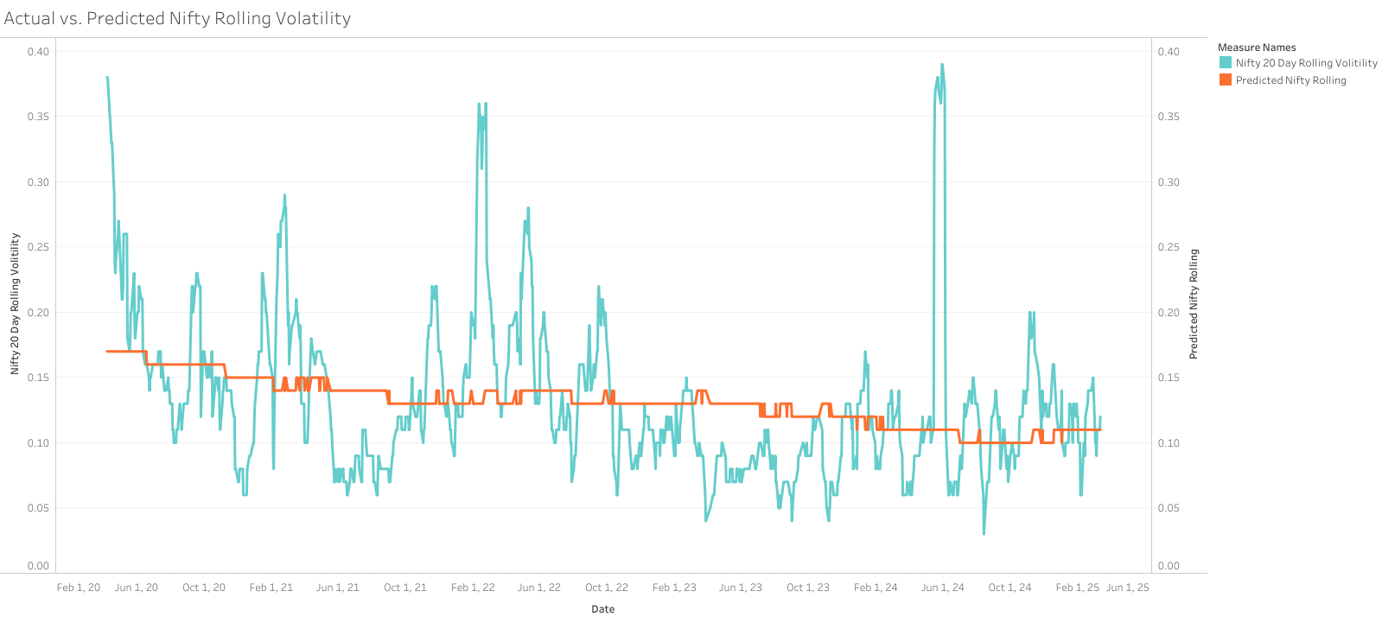

Slide 5
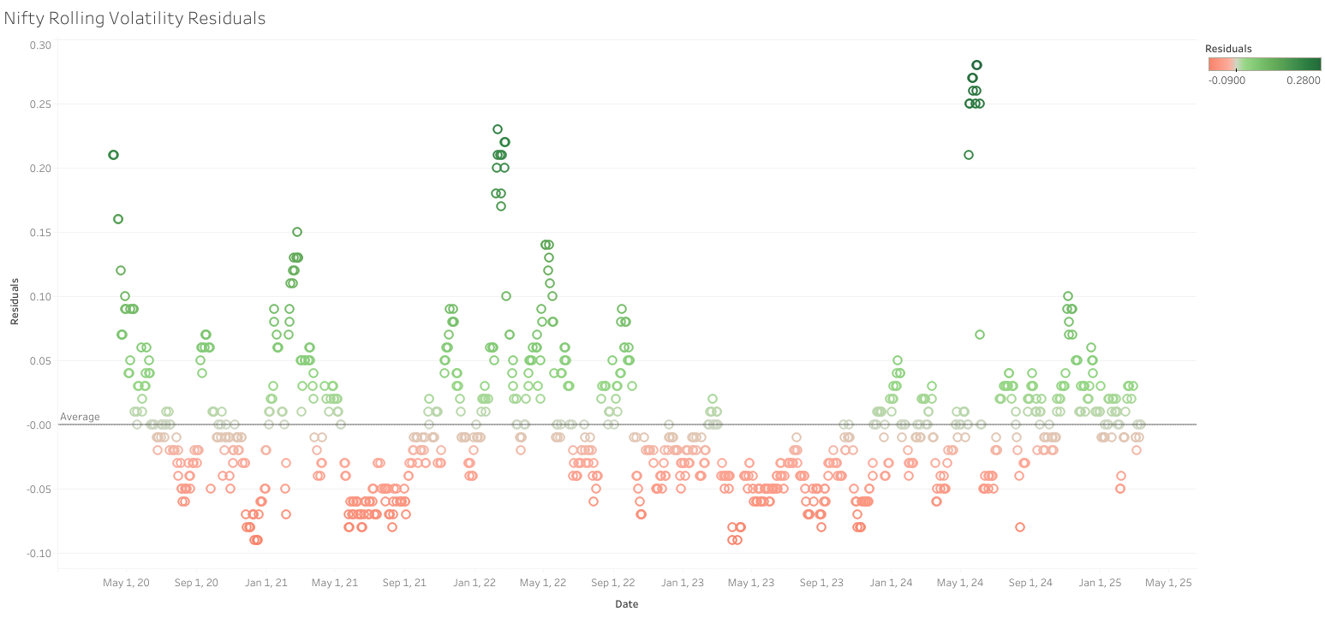

Slide 6
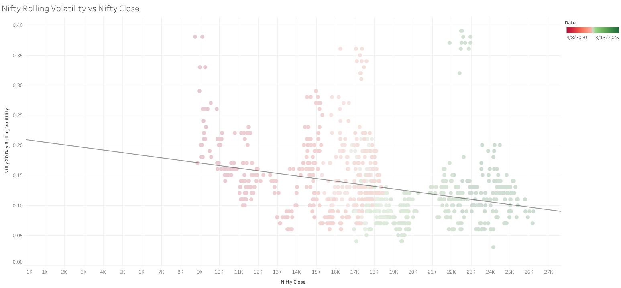

Slide 7
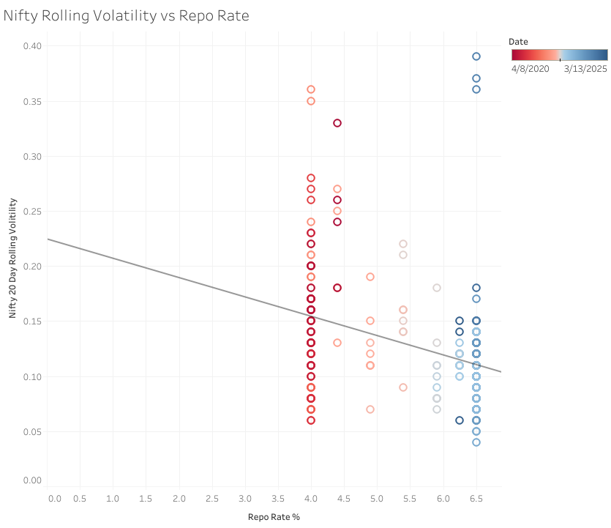

Slide 8
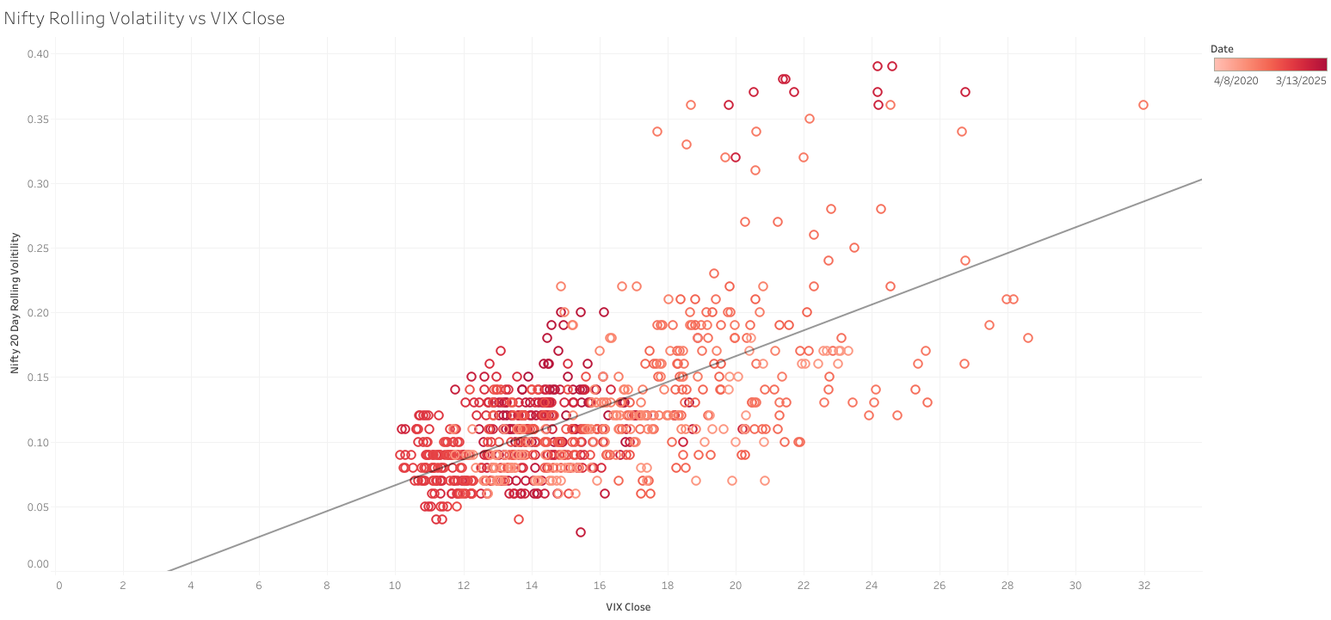

Slide 9
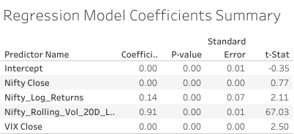
Intercept: 2.50 (p=0.00) ✅
Nifty Close: 67.03 (p=0.01) ❌
Nifty Log Returns: 2.11 (p=0.07) ❌
Nifty Lagged Volatility: 0.77 (p=0.00) ✅
VIX Close: -0.35 (p=0.01) ✅

Slide 10
Key Insights
1. Lagged Volatility and VIX are Strong Predictors
2. Current Price and Returns are Weak Predictors
3. Actual vs Predicted alignment is reasonable

Slide 11
Strategic Applications
1. Forecast volatility for options trading - This model is well-suited for short-term volatility forecasting due to the strong influence of lagged volatility.
2. Use for portfolio risk management
3. Market timing via volatility spike alerts

Slide 12
Adaptive Trading Strategy Using Nifty Regression Model Generates Alpha While Managing Risk

Slide 13
Strategy Objective
Develop an adaptive strategy using predicted 20-day rolling volatility.
Goal: Generate excess returns (alpha) while managing risk.

Slide 14
Volatility Regime Detection
Low (< 0.12): Trending market → Trend-following
Medium (0.12–0.20): Balanced → Breakout trades with hedge
High (> 0.20): Turbulent → Mean reversion & delta-neutral

Slide 15
Volatility-Weighted Position Sizing
Position Size = Target Risk / Predicted Volatility
Inverse volatility scaling ensures consistent risk exposure.
Apply caps to avoid over-leverage.

Slide 16
Trade Signal Strategy (by Volatility Regime)
Low Volatility: Trend-following (EMA crossover)
Medium Volatility: Breakouts with trailing stops
High Volatility: RSI mean reversion & option spreads

Slide 17
Hedging & Alpha from Options
High vol: Buy protective puts or sell spreads
Volatility Arbitrage:
- Predicted Vol > IV: Buy straddles
- Predicted Vol < IV: Sell straddles

Slide 18
Strategy Logic Example
If vol < 0.12: Trend-following, large size
If 0.12 ≤ vol ≤ 0.20: Breakout + hedge
If vol > 0.20: Mean-reversion + option trades

Slide 19
Model Optimization Techniques
Walk-forward testing
Bayesian parameter tuning
Sharpe & Sortino ratio maximization

Slide 20
Risk Management Framework
Max drawdown triggers
VaR-based exposure limits
ATR-based dynamic stop-losses

Slide 21
Performance Metrics to Track
Annual Return, Alpha
Sharpe, Sortino, Drawdown
Hit rate, Profit factor, Beta

Slide 22
Conclusion
By leveraging the predictive power of the Nifty volatility regression model, we can adapt to evolving market regimes in real time.
The strategy dynamically shifts between trend-following, breakout, and mean-reversion styles based on forecasted volatility.
Risk is rigorously managed through volatility-weighted sizing, hedging, and drawdown limits.
This approach ensures consistent performance, minimizes downside during turmoil, and captures excess returns across cycles.
With further optimization, macro filters, and automation, this model can become a powerful tool for institutional or retail deployment.

Slide 23
THANK YOU

